Slide 1
Latency vs. Throughput

Slide 2
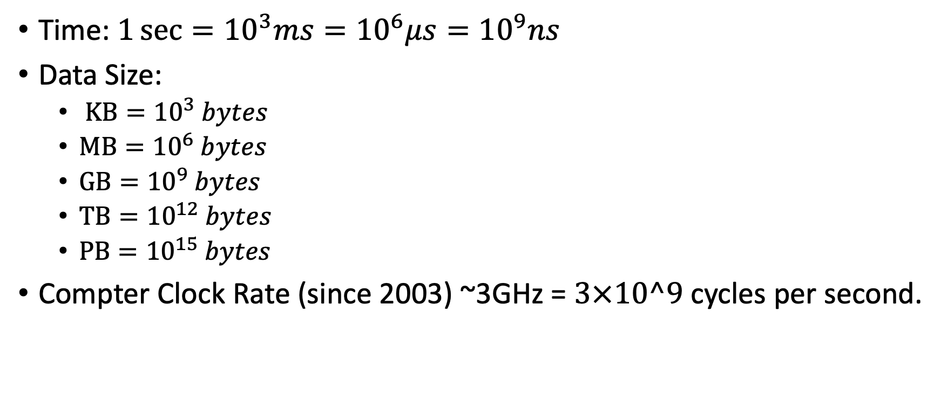
Some numbers
Time: $1\sec{={10}^{3}ms={10}^{6}μs={10}^{9}ns}$
Data Size:
$KB={10}^{3} bytes$
$MB={10}^{6} bytes$
$GB={10}^{9} bytes$
$TB={10}^{12} bytes$
$PB={10}^{15} bytes$
Compter Clock Rate (since 2003) ~3GHz = $3×10^9$ cycles per second.

Slide 3
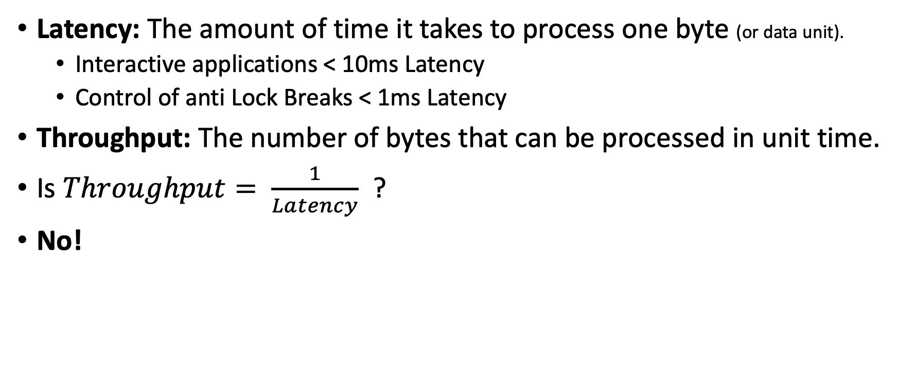
Definitions
Latency: The amount of time it takes to process one byte (or data unit).
Interactive applications < 10ms Latency
Control of anti Lock Breaks < 1ms Latency
Throughput: The number of bytes that can be processed in unit time.
Is $Throughput= \frac{1}{Latency}$ ?
No!

Slide 4

Why $Throughput≠ \frac{1}{Latency}$ ?
Sequential execution
Latency = ½ sec
Throughput = 2 byte/sec
½ sec
CPU 1
byte
byte
byte
byte
byte
Parallel execution
½ sec
byte
byte
byte
byte
byte
Latency = ½ sec
Throughput = 8 byte/sec
CPU 1
CPU 2
byte
byte
byte
byte
byte
CPU 3
byte
byte
byte
byte
byte
CPU 4
byte
byte
byte
byte
byte

Slide 5
Processing in Bulk
The latency for reading a random block from a spinning Disk is 10ms.
Why? Because of the mechanics of moving the reading head.
Instead of reading one byte, read a whole block!
Assuming all of the data in the block is useful:
Latency: 10ms (100Byte/sec for random access)
Throughput: 100MB/sec (for sequential access)
Caching: a method for achieving low latency and high throughput by assuming locality.
byte
byte
byte
byte
byte
byte
byte
byte
byte
byte
byte
byte
byte
byte
byte

Slide 6
When do we need low latency?
When interacting with our cell phone or laptop.
When playing games online: https://tetris.com/play-tetris
When viewing very large images (uses tiling technique) https://activebrainatlas.ucsd.edu/
Anything interactive – working on a jupyter notebook.
Running javascript inside a browser
Latency = reaction time < 100ms

Slide 7
When do we need high throughput
When we have a large amount of data to process, we care little about latency, we care about throughput.
Prime example: we have 50TB of data and we want to transfer it to the cloud.
Regular home line: upload speed 6Mbps = 6/8 MBps -> 771 days ~ 2 years
Fast University line: upload speed 100Mbps = 100/8 MBps -> 46 days
Dedicated fiber: upload speed 10Gbps = 10/8 GBps -> 11 hours
Dedicated fiber costs 10-100K$ per year.

Slide 8

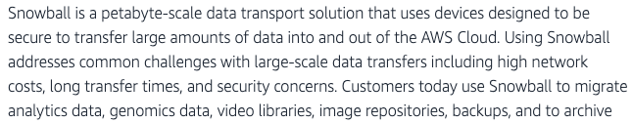
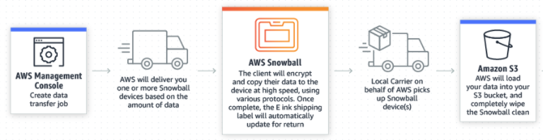
The fast and cheap option: Fedex

Slide 9
Summary
When providing an interactive experience, we care more about latency than throughput.
When processing TB, we care more about throughput than about latency.
Transmitting TB through the internet is slow and expensive.
Sending a physical disk through Fedex is cheap and high bandwidth.

Slide 10
Storage Latency

Slide 11
CPU
Storage
A
A
C
C
=
*
B
B

Slide 12
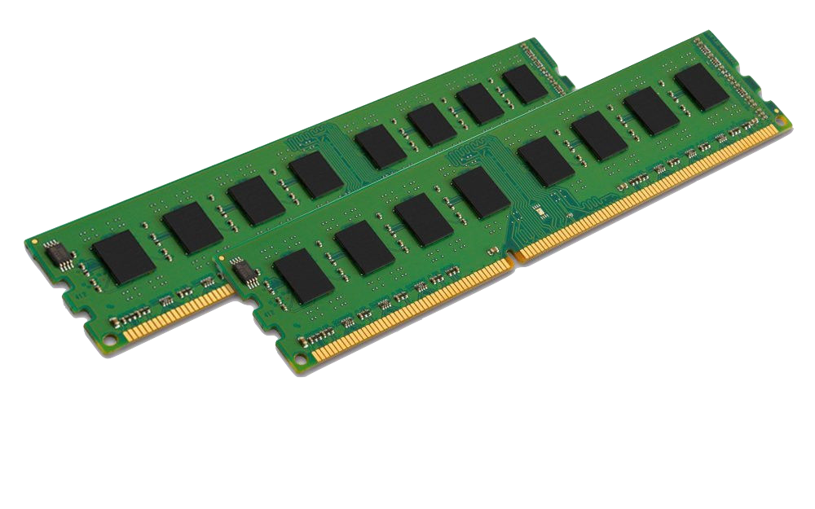
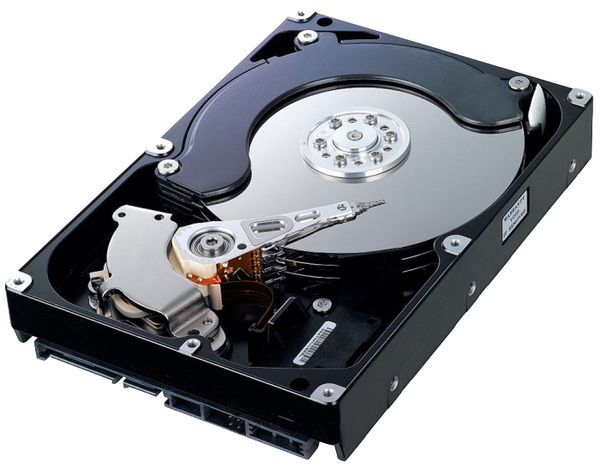
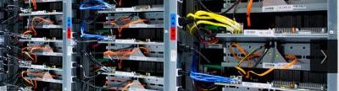
Latencies
Storage Types
Read A
Read B
C=A*B
Write C
With big data, most of the latency is memory latency (1,2,4), not computation (3)
Main Memory (RAM)
Spinning disk
Remote computer
Latency 1
Total Latency
Latency 2
TIME
Latency 3
Latency 4

Slide 13
Summary
The major source of latency in data analysis is reading and writing to storage
Different types of storage offer different latency, capacity and price.
Big data analytics revolves around methods for organizing storage and computation in ways that maximize speed while minimizing cost.
Next, storage locality.

Slide 14
Caching
Notes:
Zoom: In the previous video we saw how locality can speed up the processing of large arrays.
However, I did not say *why* locality of access is important.
In this video I will tell you how caches work, what is the memory Heirarchy, and how all that is related to memory locality.

Slide 15
Latency, size and price of computer memory
Given a budget, we need to trade off
$10: Fast & Small
$10: Slow & Large

Slide 16
Cache: The basic idea
Slow & Large
Fast & Small
Memory
0 | 1 | 2 | 3 | 4 | 5 | 6 | 7 | 8 | 9
10 | 11 | 12 | 13 | 14 | 15 | 16 | 17 | 18 | 19
20 | 21 | 22 | 23 | 24 | 25 | 26 | 27 | 28 | 29
30 | 31 | 32 | 33 | 34 | 35 | 36 | 37 | 38 | 39
40 | 41 | 42 | 43 | 44 | 45 | 46 | 47 | 48 | 49
50 | 51 | 52 | 53 | 54 | 55 | 56 | 57 | 58 | 59
60 | 61 | 62 | 63 | 64 | 65 | 66 | 67 | 68 | 69
70 | 71 | 72 | 73 | 74 | 75 | 76 | 77 | 78 | 79
Cache
cpu
12 | 67
50 | 51
52 | 53
32 | 33

Slide 17
Cache Hit
Memory
0 | 1 | 2 | 3 | 4 | 5 | 6 | 7 | 8 | 9
10 | 11 | 12 | 13 | 14 | 15 | 16 | 17 | 18 | 19
20 | 21 | 22 | 23 | 24 | 25 | 26 | 27 | 28 | 29
30 | 31 | 32 | 33 | 34 | 35 | 36 | 37 | 38 | 39
40 | 41 | 42 | 43 | 44 | 45 | 46 | 47 | 48 | 49
50 | 51 | 52 | 53 | 54 | 55 | 56 | 57 | 58 | 59
60 | 61 | 62 | 63 | 64 | 65 | 66 | 67 | 68 | 69
70 | 71 | 72 | 73 | 74 | 75 | 76 | 77 | 78 | 79
Cache
cpu
Cache Hit
12 | 67
50 | 51
52 | 53
32 | 33

Slide 18
Cache Miss
Memory
0 | 1 | 2 | 3 | 4 | 5 | 6 | 7 | 8 | 9
10 | 11 | 12 | 13 | 14 | 15 | 16 | 17 | 18 | 19
20 | 21 | 22 | 23 | 24 | 25 | 26 | 27 | 28 | 29
30 | 31 | 32 | 33 | 34 | 35 | 36 | 37 | 38 | 39
40 | 41 | 42 | 43 | 44 | 45 | 46 | 47 | 48 | 49
50 | 51 | 52 | 53 | 54 | 55 | 56 | 57 | 58 | 59
60 | 61 | 62 | 63 | 64 | 65 | 66 | 67 | 68 | 69
70 | 71 | 72 | 73 | 74 | 75 | 76 | 77 | 78 | 79
Cache
cpu
12 | 67
50 | 51
52 | 53
32 | 33

Slide 19

Cache Miss Service: 1) Choose byte to drop
Memory
0 | 1 | 2 | 3 | 4 | 5 | 6 | 7 | 8 | 9
10 | 11 | 12 | 13 | 14 | 15 | 16 | 17 | 18 | 19
20 | 21 | 22 | 23 | 24 | 25 | 26 | 27 | 28 | 29
30 | 31 | 32 | 33 | 34 | 35 | 36 | 37 | 38 | 39
40 | 41 | 42 | 43 | 44 | 45 | 46 | 47 | 48 | 49
50 | 51 | 52 | 53 | 54 | 55 | 56 | 57 | 58 | 59
60 | 61 | 62 | 63 | 64 | 65 | 66 | 67 | 68 | 69
70 | 71 | 72 | 73 | 74 | 75 | 76 | 77 | 78 | 79
Cache
cpu
12 | 67
50 | 51
52 | 53
32 | 33
67

Slide 20
Cache Miss Service: 2) write back
Memory
0 | 1 | 2 | 3 | 4 | 5 | 6 | 7 | 8 | 9
10 | 11 | 12 | 13 | 14 | 15 | 16 | 17 | 18 | 19
20 | 21 | 22 | 23 | 24 | 25 | 26 | 27 | 28 | 29
30 | 31 | 32 | 33 | 34 | 35 | 36 | 37 | 38 | 39
40 | 41 | 42 | 43 | 44 | 45 | 46 | 47 | 48 | 49
50 | 51 | 52 | 53 | 54 | 55 | 56 | 57 | 58 | 59
60 | 61 | 62 | 63 | 64 | 65 | 66 | 67 | 68 | 69
70 | 71 | 72 | 73 | 74 | 75 | 76 | 77 | 78 | 79
Cache
cpu
12
50 | 51
52 | 53
32 | 33
67

Slide 21
Cache Miss Service: 3) Read In
Memory
0 | 1 | 2 | 3 | 4 | 5 | 6 | 7 | 8 | 9
10 | 11 | 12 | 13 | 14 | 15 | 16 | 17 | 18 | 19
20 | 21 | 22 | 23 | 24 | 25 | 26 | 27 | 28 | 29
30 | 31 | 32 | 33 | 34 | 35 | 36 | 37 | 38 | 39
40 | 41 | 42 | 43 | 44 | 45 | 46 | 47 | 48 | 49
50 | 51 | 52 | 53 | 54 | 55 | 56 | 57 | 58 | 59
60 | 61 | 62 | 63 | 64 | 65 | 66 | 67 | 68 | 69
70 | 71 | 72 | 73 | 74 | 75 | 76 | 77 | 78 | 79
Cache
cpu
12
50 | 51
52 | 53
32 | 33
47

Slide 22
Access Locality
The cache is effective If most accesses are hits.
Cache Hit Rate is high.
Temporal Locality: Multiple accesses to same address within a short time period

Slide 23
Spatial locality
Spatial Locality: Multiple accesses to close-together addresses in short time period.
The difference between two sums.
Counting words by sorting
Benefiting from spatial locality
Memory is partitioned into Blocks/Lines rather than single bytes.
Moving a block of memory takes much less time than moving each byte individually.
Memory locations that are close to each other are likely to fall in the same block.
Resulting in more cache hits.

Slide 24
Summary
Caching reduces storage latency by bringing relevant data close to the CPU.
This requires that code exhibits access locality:
Temporal locality: Accessing the same location multiple times
Spatial locality: Accessing neighboring locations.

Slide 25
Locality of storage access

Slide 26
Why is access locality important?
Access locality refers to the ability of software to make good use of the cache. (details on Cache in a following video)
Memory is broken up into pages.
Software that uses the same or neighboring pages repeatedly has good access locality.
Hardware is designed to speed up such software.

Slide 27
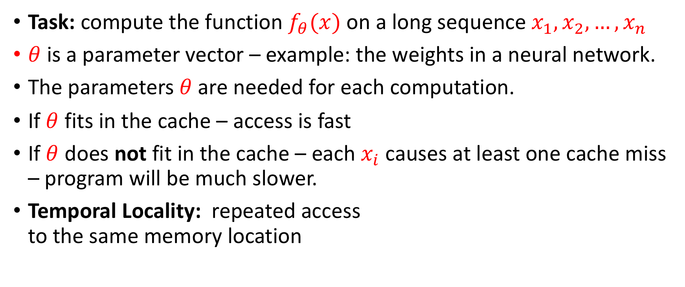
Temporal Locality
Task: compute the function $f_{θ}(x)$ on a long sequence $x_{1},x_{2},…,x_{n}$
$θ$ is a parameter vector – example: the weights in a neural network.
The parameters$θ$ are needed for each computation.
If $θ$ fits in the cache – access is fast
If $θ$ does not fit in the cache – each $x_{i}$ causes at least one cache miss – program will be much slower.
Temporal Locality: repeated access to the same memory location

Slide 28
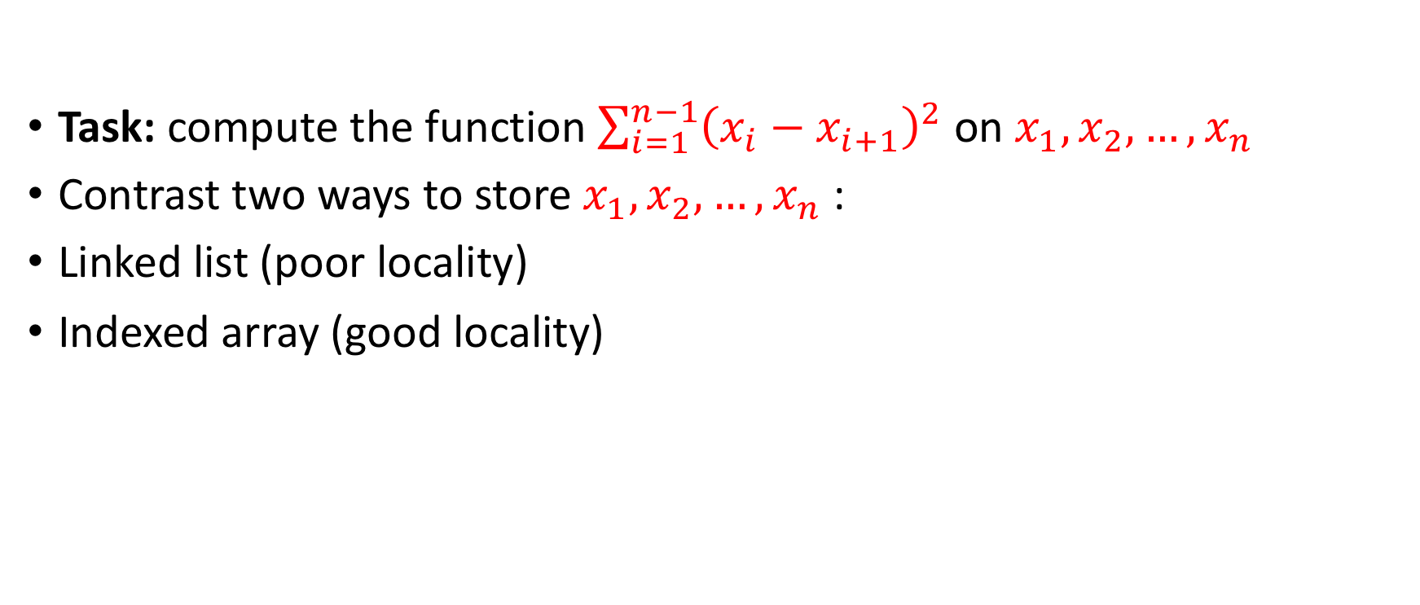
Spatial locality
Task: compute the function $\sum_{i=1}^{n−1}{{\left(x_{i}−x_{i+1}\right)}^{2}}$ on $x_{1},x_{2},…,x_{n}$
Contrast two ways to store $x_{1},x_{2},…,x_{n}$ :
Linked list (poor locality)
Indexed array (good locality)

Slide 29
Linked List
Let $x_{1},x_{2},…,x_{n}$ be 1,2,3,4,5,6
Page 1 |  |  |  |  | Page 2 |  |  |  |  | Page3 |  |  |  |  | Page4
 | 6 |  | 3 |  | 2 |  |  |  | 5 |  |  |  |  | 4 |  |  | 1
Traversal of 6 elements touches 4 pages

Slide 30
array
Let $x_{1},x_{2},…,x_{n}$ be 1,2,3,4,5,6
Page 1 |  |  |  |  | Page 2 |  |  |  |  | Page3 |  |  |  |  | Page4
 |  |  |  |  |  |  | 1 | 2 | 3 | 4 | 5 | 6
Traversal of 6 elements touches 2 pages

Slide 31
Word Count
Task: given a (large) text
Count the number of times each word
Output (word,count) sorted in decreasing order by Count.

Slide 32
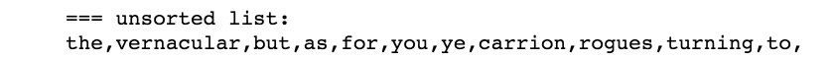
Unsorted word count / poor locality
Dict={}
For word in list:
if word in Dict:
Dict[word]+=1
else:
Dict[word]=1
Suppose
len(list)=1,000,000
len(Dict) = 100,000
Access to list: spatially local
Access to Dict: random

Slide 33
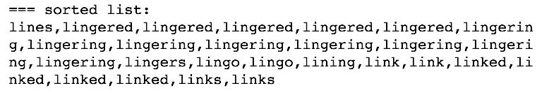
sorted word count / good locality
Suppose
len(list)=1,000,000
len(Dict) = 100,000
Access to list: spatially local
Access to Dict: Spatially local
But what about the sort step?
Sorting can be done in time O(n)
Efficient in distributed setup
Dict={}
Sort(list)
For word in list:
if word in Dict:
Dict[word]+=1
else:
Dict[word]=1

Slide 34
Summary
Improved memory locality reduces run-time
Why?
Because computer memory is organized in pages.
And caching retrieves a page at a time.

Slide 35
The memory Hierarchy

Slide 36
The Memory Hierarchy
Real systems have a several levels storage types:
Top of hierarchy: Small and fast storage close to CPU
Bottom of Hierarchy: Large and slow storage further from CPU
Caching is used to transfer data between different levels of the hierarchy.
To the programmer / compiler does not need to know
The hardware provides an abstraction : memory looks like like a single large array.
But performance depends on program’s access pattern.

Slide 37
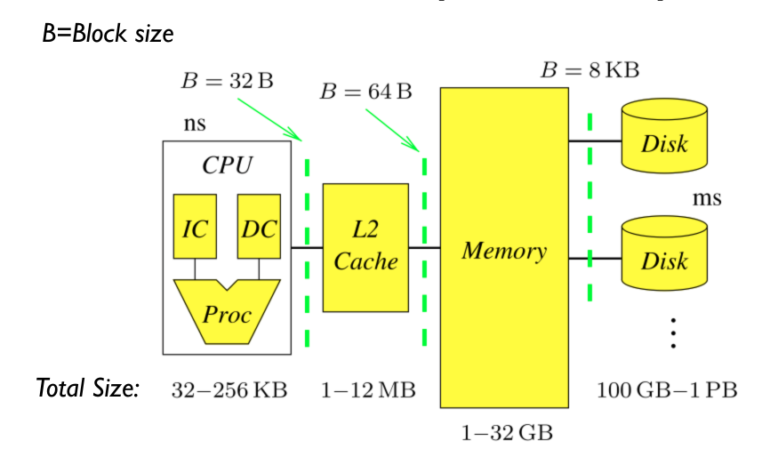
The Memory Hierarchy

Slide 38
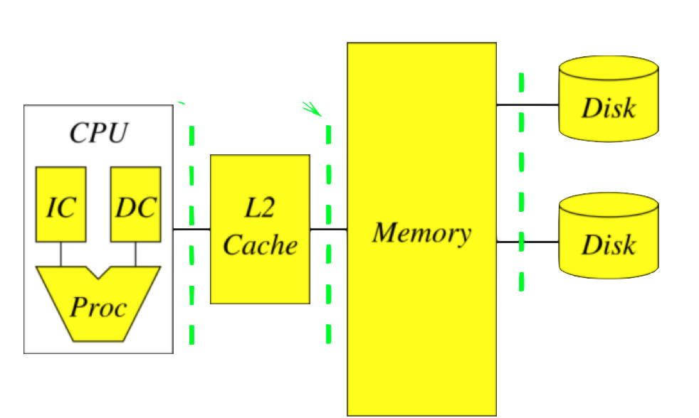
Computer clusters extend the memory hierarchy
A data processing cluster is simply many computers linked through an ethernet connection.
Storage is shared
Locality: Data to reside on the computer will use it.
“Caching” is replaced by “Shuffling”
Abstraction is spark RDD.
Ethernet

Slide 39
Sizes and latencies in a typical memory hierarchy.
 | CPU (Registers) | L1 Cache | L2 Cache | L3 Cache | Main Memory | Disk Storage | Local Area Network
Size (bytes) | 1KB | 64KB | 256KB | 4MB | 4-16GB | 4-16TB | 16TB – 10PB
Latency | 300ps | 1ns | 5ns | 20ns | 100ns | 2-10ms | 2-10ms
Block size | 64B | 64B | 64B | 64B | 32KB | 64KB | 1.5-64KB
12 orders of magnitude
6 orders of magnitude

Slide 40
Summary
Memory Hierarchy: combining storage banks with different latencies.
Clusters: multiple computers, connected by ethernet, that share their storage.

